Slide 1
Introduction to Microeconomics

Slide 2
Lecture 13 Consumer Choice: Maximizing Utility and Behavioral Economics

Slide 3
Consumer Choice: Maximizing Utility and Behavioral Economics
Utility Theory
Water is cheap, and diamonds are expensive. But water is necessary to life and diamonds are not.
Isn’t it odd—even paradoxical—that what is necessary to life is cheap, and what is not necessary is expensive?
Eighteenth-century economist Adam Smith wondered about this question. He observed that often things with the greatest value in use (or that are the most useful) have a relatively low price, and things with little or no value in use have a high price.

Slide 4
Consumer Choice: Maximizing Utility and Behavioral Economics
Utility Theory
Smith’s observation came to be known as the diamond-water paradox, or the paradox of value.
The paradox challenged economists, and they sought a solution to it. This section begins to develop parts of the solution they found.
Utility is a measure of preferences over some set of goods. Utility is the total satisfaction derived from the consumption of goods or services.

Slide 5
Consumer Choice: Maximizing Utility and Behavioral Economics
Utility Theory
Saying that a good gives you utility is the same as saying that it has the power to satisfy your wants or that it gives you satisfaction.
For example, suppose you buy your first unit of good X, and you get a certain amount of utility, say, 10 utils from it. (Utils are an artificial construct used to measure utility).
You buy a second unit of good X, and, once again, you get a certain amount of utility from this second unit, say, 8 utils.

Slide 6
Consumer Choice: Maximizing Utility and Behavioral Economics
Utility Theory
You purchase a third unit and receive 7 utils.
The sum of the amount of utility you obtain from each of the 3 units is the total utility you receive from purchasing good X: 25 utils.
Total utility is the total satisfaction one receives from consuming a particular quantity of a good (in this example, 3 units of good X).

Slide 7
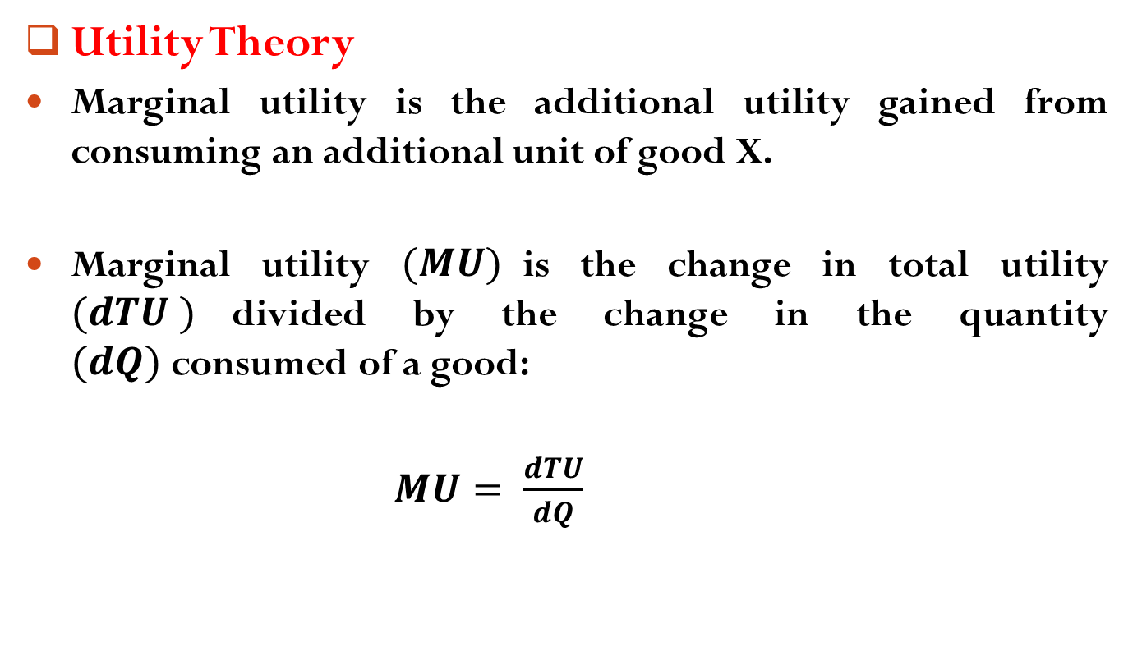
Consumer Choice: Maximizing Utility and Behavioral Economics
Utility Theory
Marginal utility is the additional utility gained from consuming an additional unit of good X.
Marginal utility $(MU)$is the change in total utility $(dTU )$divided by the change in the quantity $(dQ)$consumed of a good:
$MU= \frac{ⅆTU}{dQ}$

Slide 8
Consumer Choice: Maximizing Utility and Behavioral Economics
Utility Theory
To illustrate, suppose you receive 10 utils of total utility from consuming 1 apple and 19 utils of total utility from consuming 2 apples.
The marginal utility of the second apple (the additional utility of consuming an additional apple) is 9 utils.
As a person consumes more apples, total utility rises, but marginal utility (additional utility received from the additional apple) falls.

Slide 9
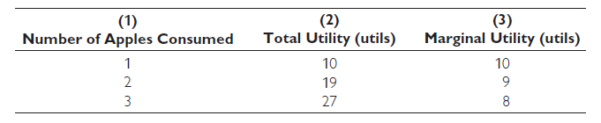
Consumer Choice: Maximizing Utility and Behavioral Economics
Utility Theory

Slide 10
Consumer Choice: Maximizing Utility and Behavioral Economics
Law of Diminishing Marginal Utility
The law of diminishing marginal utility states that, for a given time period, the marginal utility gained by consuming equal successive units of a good declines as the amount consumed increases.
In other words, the number of utils gained by consuming the first unit of a good is greater than the number of utils gained by consuming the second unit.
The law of diminishing marginal utility is illustrated in Exhibit 1.

Slide 11
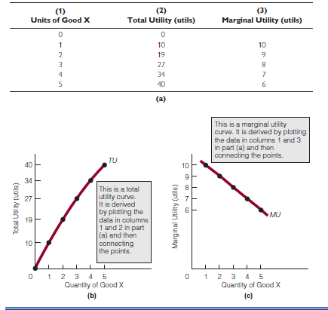
Consumer Choice: Maximizing Utility and Behavioral Economics
Law of Diminishing Marginal Utility

Slide 12
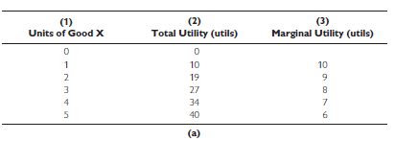
Consumer Choice: Maximizing Utility and Behavioral Economics
Law of Diminishing Marginal Utility
The table in part (a) shows both the total utility of consuming a certain number of units of a good and the marginal utility of consuming additional units.

Slide 13
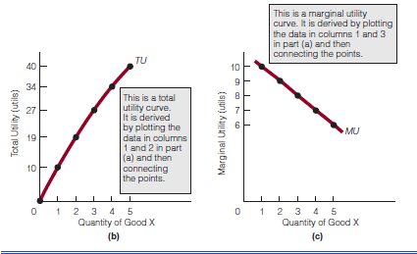
Consumer Choice: Maximizing Utility and Behavioral Economics
Law of Diminishing Marginal Utility
The graph in part (b) shows the total utility curve for the data in part (a), and the graph in part (c) shows the marginal utility curve for the data in part (a).

Slide 14
Consumer Choice: Maximizing Utility and Behavioral Economics
Law of Diminishing Marginal Utility
The graphs in parts (b) and (c) show that total utility can increase as marginal utility decreases.
This relationship between total utility and marginal utility is important in unraveling the diamond-water paradox.

Slide 15
Consumer Choice: Maximizing Utility and Behavioral Economics
The Solution to the Diamond-Water Paradox
Goods have both total utility and marginal utility.
Water, for example, is extremely useful; we cannot live without it. We would expect its total utility (its total usefulness) to be high but its marginal utility to be low because water is relatively plentiful.
As the law of diminishing marginal utility states, the utility of successive units of a good diminishes as its consumption increases.

Slide 16
Consumer Choice: Maximizing Utility and Behavioral Economics
The Solution to the Diamond-Water Paradox
In short, water is immensely useful, but there is so much of it that individuals place relatively little value on another unit of it.
In contrast, diamonds are not as useful as water. We would expect the total utility of diamonds to be lower than that of water, but their marginal utility to be high.
Because there are relatively few diamonds in the world, their consumption (in contrast to water consumption) takes place at relatively high marginal utility.

Slide 17
Consumer Choice: Maximizing Utility and Behavioral Economics
The Solution to the Diamond-Water Paradox
Diamonds, which are rare, are used only for their few valuable uses.
Water, which is plentiful, gets used for its many valuable uses and for its not so valuable uses.
So the total utility of water is high because water is extremely useful. The total utility of diamonds is comparatively low because diamonds are not as useful as water.

Slide 18
Consumer Choice: Maximizing Utility and Behavioral Economics
The Solution to the Diamond-Water Paradox
The marginal utility of water is low because water is so plentiful that people consume it at low marginal utility.
The marginal utility of diamonds is high because diamonds are so scarce that people consume them at high marginal utility.
Prices therefore reflect marginal utility, not total utility.

Slide 19
Consumer Choice: Maximizing Utility and Behavioral Economics
Consumer Equilibrium and Demand
This section identifies the condition necessary for consumer equilibrium and then discusses the relationship between equilibrium and the law of demand.
The analysis is based on the assumption that individuals seek to maximize utility.

Slide 20
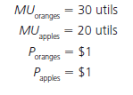
Consumer Choice: Maximizing Utility and Behavioral Economics
Equating Marginal Utilities per Dollar
Suppose there are only two goods in the world: apples and oranges.
At present, a consumer is spending his entire income consuming 10 apples and 10 oranges a week. For a particular week, the marginal utility (MU ) and price (P ) of each are as follows:

Slide 21

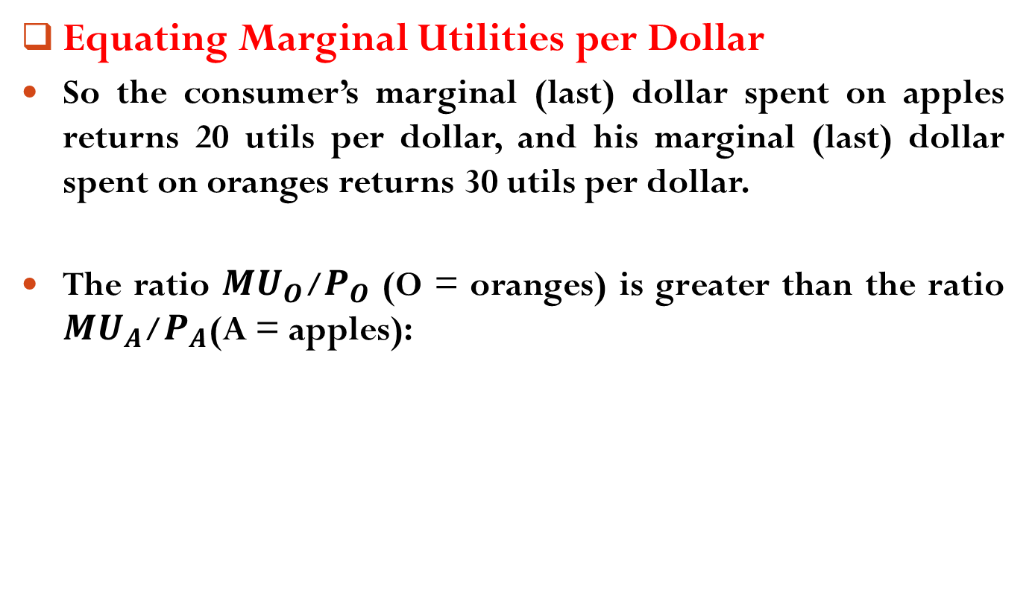
Consumer Choice: Maximizing Utility and Behavioral Economics
Equating Marginal Utilities per Dollar
So the consumer’s marginal (last) dollar spent on apples returns 20 utils per dollar, and his marginal (last) dollar spent on oranges returns 30 utils per dollar.
The ratio ${MU}_{O}$/$P_{O}$ (O = oranges) is greater than the ratio ${MU}_{A}$/$P_{A}$(A = apples):

Slide 22
Consumer Choice: Maximizing Utility and Behavioral Economics
Equating Marginal Utilities per Dollar
If the consumer recognizes this fact one week, he might redirect his purchases of apples and oranges the next week.
“If I buy an orange, I receive more utility [30 utils] than if I buy an apple [20 utils]. It’s better to buy 1 more orange with $1 and 1 less apple. I gain 30 utils from buying the orange, which is 10 utils more than if I buy the apple.”
As the consumer buys 1 more orange and 1 less apple, however, the marginal utility of oranges falls, and the marginal utility of apples rises.

Slide 23
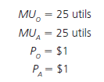
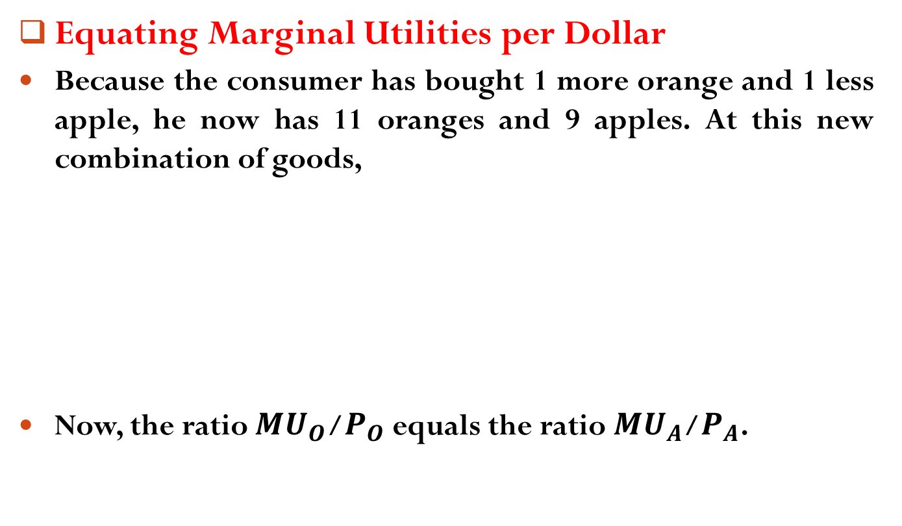
Consumer Choice: Maximizing Utility and Behavioral Economics
Equating Marginal Utilities per Dollar
Because the consumer has bought 1 more orange and 1 less apple, he now has 11 oranges and 9 apples. At this new combination of goods,
Now, the ratio ${MU}_{O}$/$P_{O}$equals the ratio ${MU}_{A}$/$P_{A}$.

Slide 24
Consumer Choice: Maximizing Utility and Behavioral Economics
Equating Marginal Utilities per Dollar
The consumer is getting exactly the same amount of utility (25 utils) per dollar from each of the two goods.
There is no way for the consumer to redirect his purchases (i.e., buy more of one good and less of another good) and have more utility.
Thus the consumer is in equilibrium; that is, he or she derives the same marginal utility per dollar for all goods.

Slide 25

Consumer Choice: Maximizing Utility and Behavioral Economics
Equating Marginal Utilities per Dollar
The condition for consumer equilibrium is,
where the letters A–Z represent all the goods a person buys.

Slide 26
Consumer Choice: Maximizing Utility and Behavioral Economics
Equating Marginal Utilities per Dollar
A person in consumer equilibrium has maximized total utility.
By spending his or her dollars on goods that give the greatest marginal utility and in the process bringing about the consumer equilibrium condition, the consumer is adding as much to total utility as possible.

Slide 27
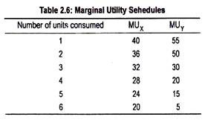
Consumer Choice: Maximizing Utility and Behavioral Economics
Equating Marginal Utilities per Dollar
Suppose there are two commodities X & Y and the price of commodity X is $4 and Y is $5. Let income of the consumer is $35. How much of commodities X and Y will the consumer purchase to maximize her utility?

Slide 28
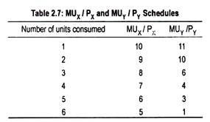
Consumer Choice: Maximizing Utility and Behavioral Economics
Equating Marginal Utilities per Dollar
To maximize utility consumer should purchase 5 units of commodity X and 3 units of commodity Y.

Slide 29
Consumer Choice: Maximizing Utility and Behavioral Economics
Equating Marginal Utilities per Dollar
Given the following information,
Find the marginal utility of commodities X and Y.
If the price of commodity X is $2 and Commodity Y is $3 and if the income of a typical consumer is $24, how many commodities of X and Y should the consumer consume to maximize her utility?
Units of Commodities (Qty.) | Total Utility of Commodity X (TU_{X}) | Total Utility of Commodity Y (TU_{Y})
1 2 3 4 5 6 | 20 38 54 68 80 90 | 24 45 63 78 90 99

Slide 30


Consumer Choice: Maximizing Utility and Behavioral Economics
Maximizing Utility and the Law of Demand
Suppose a consumer of oranges and apples is currently in equilibrium; that is,
When in equilibrium, the consumer is maximizing utility.
Now suppose the price of oranges falls. The situation now becomes:

Slide 31
Consumer Choice: Maximizing Utility and Behavioral Economics
Maximizing Utility and the Law of Demand
The consumer will attempt to restore equilibrium by buying more oranges and fewer apples.
This behavior —buying more oranges when their price falls—is consistent with the law of demand.
Therefore, the consumer’s attempt to reach equilibrium—which is another way of saying that the consumer is seeking to maximize utility—is consistent with the law of demand.

Slide 32
Readings
Roger A. Arnold- Microeconomics, 10th Edition, Chapter – 7.

Slide 33


Slide 34
Thank You

